Slide 1
Brio and Co
Website Process Step By Step
Created by Zahra Rangwala
Kbizz Solutions.com

Slide 2
Home Page and other pages as given by Brio N Co
About | Stories | Showcase | Contact

Slide 3
Home Page Structure
Graphics in the background will be placed based on the images selected by client either from royalty free photo sites or images owned previously by client. All images are property of client once placed on the website.
Home page will consist of the following links:
Home, About, Stories, Showcase, Contact

Slide 4
About
Page with content and details about Brio n Co,

Slide 5
Stories – Page concept
Introduction to Italian shoemaking tradition (fixed content)-
Map of Italy and production areas (At launch only one region and another to watch, no need for options. Later more regions and option to choose from
Stories
At launch:
One region, three stories.
Another story outlined as introduction to another region coming up next. Each story has a photo of the products and a link to the Showcase page. Later, more regions and manufacturers will be added in.

Slide 6
Programming concept and setup for stories page – Backend
Client will login to backend – Backend will have option to Add Regions, Add Stories
Client clicks Add Regions form opens us asking the following
Name of region to be added - Client will enter the Region and now they are saved in our backend
Client clicks Add Story form opens us asking the following
Name of Supplier to be added – Client will enter the Supplier and now they are saved in our backend.
Bio / Story – Client will enter the details and that will be saved in our backend.

Slide 7
Website page how it will look: Visitor side
Visitor will arrive on the showcase page. The header will have a map of Italy. They page will have Italy already selected, and all selected. So all of our suppliers will be displayed.. However if the visitor Selects Region only suppliers from that region will be displayed on the page.
Italy
Example Supplier by Region
Supplier one bio
Link to Showcase of products will go to showcase page with all the pictures
Supplier two bio
Link to Showcase of products will go to showcase page with all the pictures

Slide 8
Showcase Page of Inventory
On the showcase page: Header image will be editable so client can update when needed without designers help. Client will be provided with dimensions and help file on how to update this.
Bottom page will have Pictures. Client will login to the backend and click on Add photos to showcase:
A form opens up asking product details, images, shipping (free or fixed)
This info will be saved. Also the help file provided will assist with this addition of products. These products will display as uploaded on the main website

Slide 9
Contact Page
contact and a small form that they can fill out if they have any questions.
Name, Email, Comment – Submit
Email info@brioandco.com
Click Here to like our fb page
Visit our fb page for upcoming product showcase information.

Slide 10
Payment
Once a client clicks on the showcase page and looks at a product they would like to purchase they will have two buttons,
Add to cart or details
Add to cart takes them to registration/ guest checkout page
Details take them to product details page where this is details and option to add to cart again.
Once they go through with the registration or guest checkout
1) client receives an email that someone registered with their info.
2) If they select guest checkout we cannot get any info from them as they do not want to provide so we collect name, and shipping address info only
Continued next slide

Slide 11
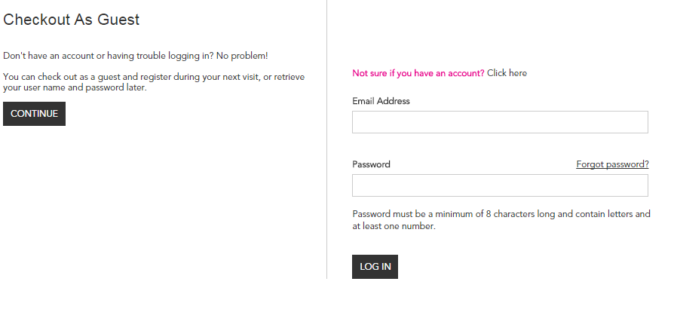
Payment checkout sample

Slide 12
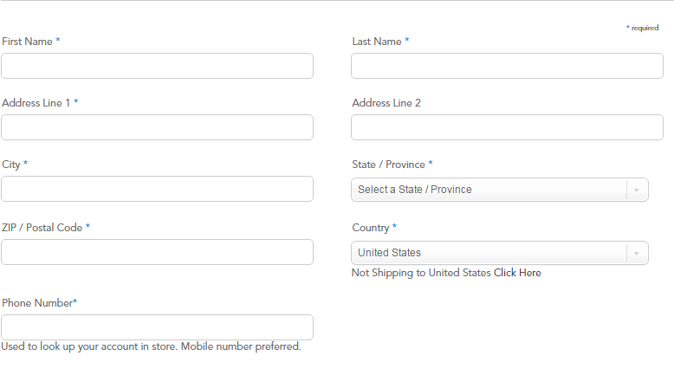
Shipping Guest Checkout Sample

Slide 13
Payment – Emails
Email 1: registration if they do. Not if they do guest checkout
Email 2: Once they checkout and go to paypal to pay. They will receive two emails after payment. One from us once we confirm we received the payment and one from paypal.
Email 3: Email will be sent once you ship and you can come back and send an email with tracking info and a preset msg.

Slide 14
Backend info for Admin
Admin will be able to view the orders received,
Admin will be able to send shipping info to orders shipped
Admin can review payment received
Admin can add more regions
Admin can add more suppliers
Admin can add product showcase (pictures and details)

Slide 15
Visitors can:
Create an account with purchase
Login to the account to view items purchased history
Login whenever they need to purchase more items
Reset their profile emails, names etc
Reset their passwords.
Forgot password
On website login info

